Slide 1
FHIR for Executives (1 of 2)
Lloyd McKenzie
December 1, 2014

Slide 2
This presentation
Can be downloaded here:
http://gforge.hl7.org/svn/fhir/trunk/presentations/2014-12 Webinars/FHIR For Executives1.pptx
Use “anonymous” and email address to logon
Is licensed for use under the Creative Commons, specifically:
Creative Commons Attribution 3.0 Unported License
(Do with it as you wish, so long as you give credit)

Slide 3

Who am I?
Name: Lloyd McKenzie
Company: Gevity
Background:
One of FHIR’s 3 principle editors
Co-chair FHIR Management Group
Co-chair HL7 Modeling & Methodology
Chair HL7 Canada Architecture & Infrastructure
Heavily involved in HL7 and healthcare exchange for last 15 years (v2, v3, CDA, etc.)

Slide 4
Tutorial Objectives
You should:
Know where FHIR fits in the broader healthcare landscape, including other HL7 specifications
Be able to explain what FHIR is to others in your organization
Be able to evaluate whether and how FHIR is relevant to your organization and within what timelines
Have a basic picture of what’s happening in the FHIR implementation space right now
Notes:
9:15

Slide 5
Outline
Monday
Tuesday
Why FHIR?
What makes FHIR different?
Core principles
FHIR Resources
Power of an interface
How does FHIR Compare?
FHIR Status
Where is FHIR being used?
Risks & Next steps
Notes:
Each day – 1 hour presentation, 30 minutes

Slide 6
WHY FHIR?

Slide 7
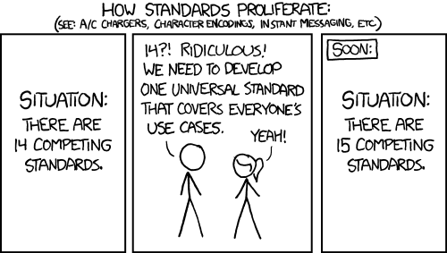
http://xkcd.com/927

Slide 8
Existing standards and bodies
HL7 – v2, v3, CDA
OpenEHR
CDISC – SDTM, ADAM, define.xml
X12
CTS
ISO – 11179, 21090, etc.
DICOM
W3C – Xforms, XSD
Many others
Do we really need one more?
Notes:
(in the healthcare space)

Slide 9
The Need
Has been a need to share healthcare information electronically for a long time
HL7 v2 is nearly 30 years old
Increasing pressure to broaden scope of sharing
Across organizations, disciplines, even borders
Mobile & cloud-based applications
Faster – integration in days or weeks, not months or years
Notes:
Who

Slide 10
What we have – v2
Works relatively well within institutions
But
Legacy, custom syntax (learning curve, tools)
Messaging design limits architectures
Doesn’t scale well across organization boundaries
Security/privacy infrastructure is minimal
A potpourri of segments and fields with no means to distinguish the common from edge case

Slide 11
What we have – v3
Newer technology and semi-robust reference model, but
Steep learning curve
Primary implementations by those with $$$$s
No inter-version wire compatibility
International specifications are too abstract, regional implementations don’t interoperate

Slide 12
What we have - CDA
Broad implementation, human-to-human interoperability, but:
Still a very steep learning curve
Interoperability beyond a human-to-human level is still a challenge, even with templates
Document architecture doesn’t fit all problems
Still a diversity of implementations
Extensibility is difficult

Slide 13
So I should drop everything and use FHIR?
Tossing functioning systems the instant a promising newcomer appears is not generally a wise strategy
There’s room for something better
FHIR tries to fill that gap
Market will decide whether FHIR survives, coexists or replaces other products
Notes:
There are flaws in what exists
There are new use-cases not being met

Slide 14
What is FHIR?
And how is it different?

Slide 15
The acronym
F – Fast (to design & to implement)
Relative – No technology can make integration as fast as we’d like
H – Health
That’s why we’re here
I – Interoperable
Ditto
R – Resources
Building blocks – more on these to follow
Notes:
9:25

Slide 16

Genesis of FHIR
What would healthcare exchange look like if we started from scratch using modern approaches?
Web search for success markers led to RESTful based APIs
Exemplar: Highrise (https://github.com/37signals/highrise-api)
Drafted a healthcare exchange API based on this approach

Slide 17
FHIR – Key differences
Focus on Implementers
Target support for common scenarios
Leverage cross-industry web technologies
Require human readability as base level of interoperability
Make content freely available
Support multiple paradigms & architectures
Demonstrate best practice governance
Notes:
We don’t actually have a formal manifesto, but these are the principles we adhere to.

Slide 18
Implementer Focus
Specification is written for one target audience: implementers
Rationale, modeling approaches, etc. kept elsewhere
Multiple reference implementations from day 1
Publicly available test servers
Starter APIs published with spec
C#, Java, Javascript, Objective C, Delphi
Connectathons to verify specification approaches
Instances you can read and understand ☺
Lots of examples (and they’re valid too)
using HL7.Fhir.Instance.Model;
using HL7.Fhir.Instance.Parsers;
using HL7.Fhir.Instance.Support;
XmlReader xr = XmlReader.Create(
new StreamRead
IFhirReader r = new XmlFhirReader
// JsonTextReader jr = new JsonTe
// new StreamRead
// IFhirReader r = new JsonFhirRe
ErrorList errors = new ErrorList(
LabReport rep = (LabReport)Resour
Assert.IsTrue(errors.Count() == 0
Notes:
Spec is driven by people who write code
Numerous pieces have been changed because of experience with what worked when trying to implement
Even have a test workbench for RESTful servers

Slide 19
Support “Common” Scenarios
80%
Inclusion of content in core specification is based on “80%” rule
Only include data elements that most systems (“80%”) currently support
Other content pushed to extensions
(more on this later)
I.e. Focus on the real, allow for the theoretical
Easy to say, governance challenge to achieve
Notes:
Design by constraint failed – years to develop, what was produced required yet more design to be implementable and after that might not be interoperable
How to determine the 80%? Look to existing specs – v2, v3, CDA templates, OpenEHR, jurisdictional projects, what implementations we’ve seen
If not sure, err on the side of “not in for now”
Note: not 80% of instances, 80% of implementations
Challenges with “raising the bar”
What happens when there aren’t many/any implementations?

Slide 20
Example – ISO AD type
isNotOrdered, updateMode, flavorId, nullFlavor, controlAct root & extension, validTime low and high, useable period (GTS – no room on the slide), use
home, primary home, vacation home, workplace, direct, public, bad, physical, postal, temporary, alphabetic, ideographic, syllabic, search, soundex, phonetic
0..* parts, each with:
value, code, code system, code system name, code system version, language, type:
address line, additional locator, unit identifier, unit designator, delivery address line, delivery installation type, delivery installation area, delivery installation qualifier, delivery mode, delivery mode identifier, street address line, building number, building number numeric, building number suffix, street name, street name base, street type, direction, intersection, care of, census tract, country, county or parish, municipality, delimiter, post box, precinct, state or province, postal code, delivery point identifier
Notes:
How many of your systems have user interfaces that support even ¼ of this?

Slide 21
Example – FHIR Address
isNotOrdered, updateMode, flavorId, nullFlavor, controlAct root & extension, validTime low and high, useable period (low, high) (GTS – no room on the slide), use
home, primary home, vacation home, workplace, direct, public, bad, physical, postal, temporary, alphabetic, ideographic, syllabic, search, soundex, phonetic, old
0..* parts, each with:text
value, code, code system, code system name, code system version, language, type:
address line, additional locator, unit identifier, unit designator, delivery address line, delivery installation type, delivery installation area, delivery installation qualifier, delivery mode, delivery mode identifier, street address line, building number, building number numeric, building number suffix, street name, street name base, street type, direction, intersection, care of, census tract, country, county or parish, municipalitycity, delimiter, post box, precinct, state or province, postal codezip, delivery point identifier
Notes:
This is what happens when you apply the 80% . . .

Slide 22
Won’t extensions break interoperability?
The 80% + narrative helps provide “base” interoperability
For “robust” interoperability
Profile – constrains structure
Conformance – constrains behavior
Needed to claim “I’m FHIR conformant”
Notes:
1000s of extensions, everyone supports different things, don’t know what anyone does
Not everyone will support the 80%, but most will
“What most systems support” (and thus what you should probably support too) encourages base interoperability
Human readable fallback
Profile – what elements are supported, registries available
Conformance – REST operations, documents, messages, services

Slide 23
Web technologies
Use the same technologies as Google, Facebook, etc.
XML, JSON, ATOM, HTTPS, Oauth
Benefits
Cross-Industry standards
Well supported by tools
Understood by developers
http://...
Notes:
We try very hard to *not* invent stuff that exists elsewhere unless it’s really broken or totally unaligned with the FHIR principles.

Slide 24
Paradigms
FHIR supports 4 interoperability paradigms
REST – Lightweight, leverages web stack
Documents – Long-term persistence
Messages – Request/response paradigm
Services – other SOA-based interfaces
Regardless of approach, content stays the same
Can leverage same models, same profiles everywhere

Slide 25

Architectures
FHIR makes no assumptions about the architectural design of systems
Notes:
Light or heavy clients
Central server or peer-to-peer sharing
Push or pull
Query or publish/subscribe
Loosely coupled or tightly coupled environments
With history tracking or without

Slide 26
FHIR – Bottom line
Faster to learn & implement
Lower cost
Scales well from simple to complex
Flexible
Free
Notes:
Focus on Implementers
Target support for common scenarios
Leverage cross-industry web technologies
Require human readability as base level of interoperability
Make content freely available
Support multiple paradigms & architectures
Demonstrate best practice governance
Less learning curve, more support, standard technologies
We support the 80%, use extensions for the rest
Support a range of architectures

Slide 27
FHIR Resources
Notes:
10:00

Slide 28
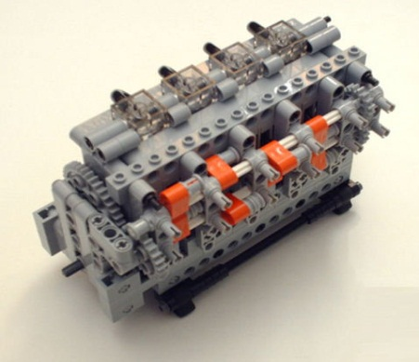
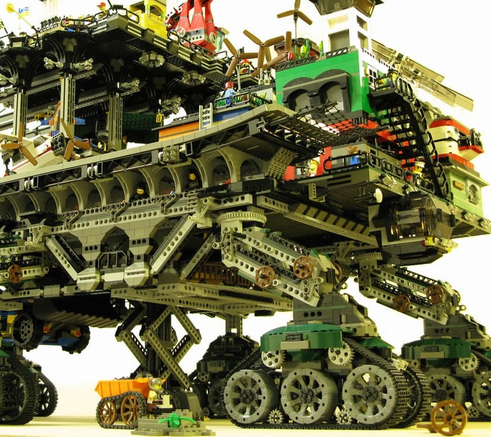

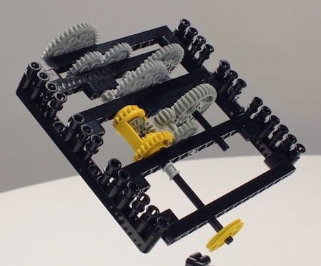
FHIR solutions
Resources
Extensions
Solution
+
=
Notes:
Resources are building blocks, but useful in their own right
Extensions supplement what resource doesn’t cover
Solutions can be simple or complex

Slide 29

Resources
“Resources” are:
Small logically discrete units of exchange
Defined behaviour and meaning
Known identity / location
Smallest unit of transaction
“of interest” to healthcare
V2: Sort of like Segments
V3: Sort of like CMETs

Slide 30
What’s a Resource?
Examples
Non-examples
Administrative
Patient, Practitioner, Organization, Location, Coverage, Invoice
Clinical Concepts
Allergy, Condition, Family History, Care Plan
Infrastructure
Document, Message, Profile, Conformance
Gender
Too small
Electronic Health Record
Too big
Blood Pressure
Too specific
Intervention
Too broad
100-150 total - ever
Notes:
And few systems will ever see more than 40-50

Slide 31
Resource anatomy
Resources have 3 parts
Extensions
Narrative
Defined
Structured
Data
Notes:
Defined Structured Data
The logical, common contents of the resource
Mapped to formal definitions/RIM & other formats
Extensions
“Non-common” requirements, but everyone can use
Published and managed
Narrative
Human readable (fall back)

Slide 32
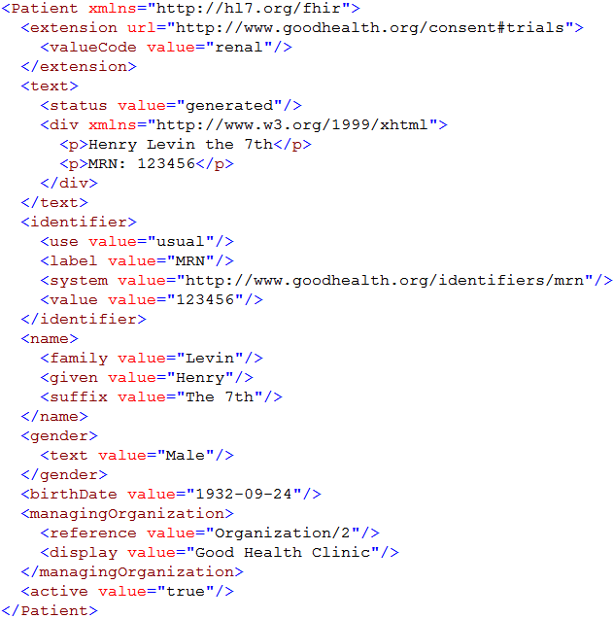
Patient resource instance
Extension with reference to its definition
Human Readable Summary
Standard Data Content:
Medical Record Number
Name
Gender
Date of Birth
Provider
Notes:
System for gender is wrong . . .

Slide 33
Why resources?
Increases re-use
Can use the same resource structures (and profiles on them) in many solutions
Lighter-weight communication
Can point to resources “by reference” rather than sending all data
Aligns well with how data is stored

Slide 34
What’s in a resource definition?
Each resource defines:
What elements are part of “core”
Names
Definitions
Cardinality
Code lists
Mappings (to RIM, v2 and other specs)
Constraints
All in a computable form
Create spec, schemas, reference implementations

Slide 35
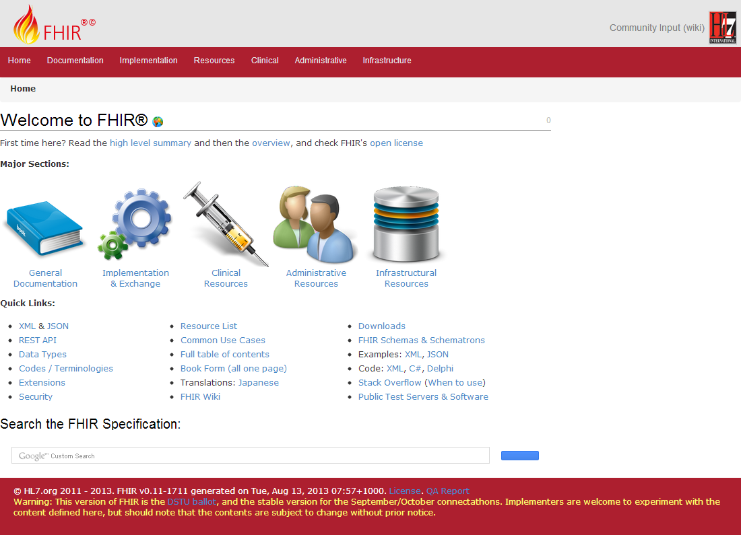
(FHIR home)
hl7.org/fhir
Notes:
Published as HTML
Published using validation process that performs consistency checks – like a software build
Really shouldn’t require much guidance to read, but a few things to call out
Objective of spec is developer can skim and decide in < day

Slide 36
Power of interfaces
FHIR’s RESTful interface makes it easier to share data
Clients (with authorization/consent) just access the data they need
What they do with it is up to them:
Analytics, reporting, decision support, personal health record
Freeing data can enable new business models and new companies
Notes:
Sabre & Galileo – Travelocity, hotels.com, TripAdvisor

Slide 37
Outline
Monday
Tuesday
Why FHIR?
What makes FHIR different?
Core principles
FHIR Resources
How does FHIR Compare?
FHIR Status
Where is FHIR being used?
Risks & Next steps

Slide 38

Questions?
http://hl7.org/fhir lmckenzie@gevityinc.com

